Slide 1
Homework
You are now a reporter. Recently there is a murder that involves juvenile delinquency(青少年犯罪). Given a raw “input.txt” file that contains the report with the teenange name, your job is to write a program that replaces the specific words with “***” to protect the teenagers. Finally, save the revised file to another file named “output.txt”.
Input: the number of words to be replaced
the first word
the second word
…
Output: the revised report with filename “output.txt”

Slide 2
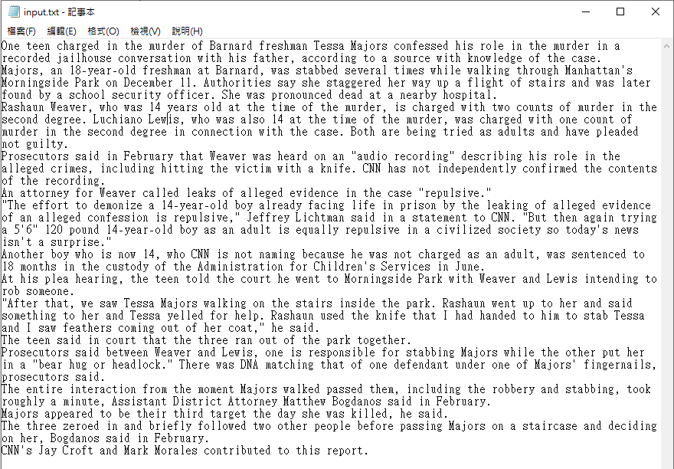
Homework

Slide 3
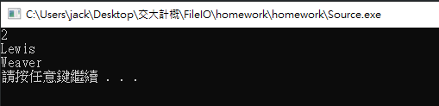
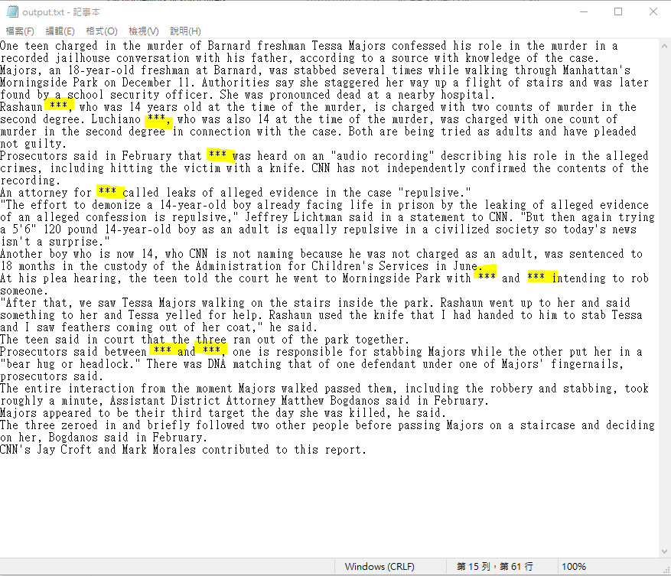

Slide 4
Note
You should not modify the “input.txt”
Hint: it would be easier if you use
strcat(), strcmp(), strcpy(), strlen()
and also watch out the ‘\0’ problem.

